Slide 1
Symbioses
April 16, 2019

Slide 2
Ice-breaker questions
What is a symbiosis?
Why would a plant establish a symbiosis?
How would a scientist identify a symbiosis?
What are some examples of symbioses involving plants?

Slide 3
Today’s symbioses
Mycorrhizae
N-fixing bacteria
Fungal endophytes

Slide 4
Today’s symbioses
Mycorrhizae
N-fixing bacteria
Fungal endophytes

Slide 5
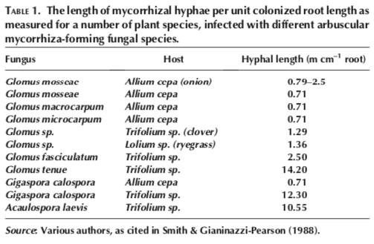
Mycorrhizae Basics
Associated with plant roots
82% of plant species
Increase root surface area
Similar to root hairs
Increase absorptive surface
Increases nutrient uptake
Primarily N and P

Slide 6
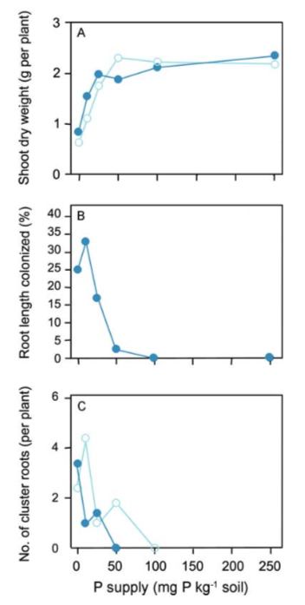
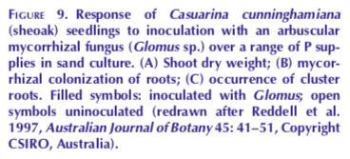
Plants regulate the symbiosis

Slide 7
Types of Mycorrhizae
Arbuscular Mycorrhiza
Ectomycorrhiza
Ericoid Mycorrhiza
Orchid Mycorrhiza

Slide 8
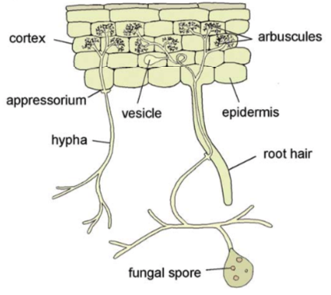
Arbuscular Mycorrhiza (AM)
Most widespread association
92% of all plant families
Trade nutrients for Carbon via arbuscules
Use vesicles for storage
Increase inorganic N and P acquisition

Slide 9
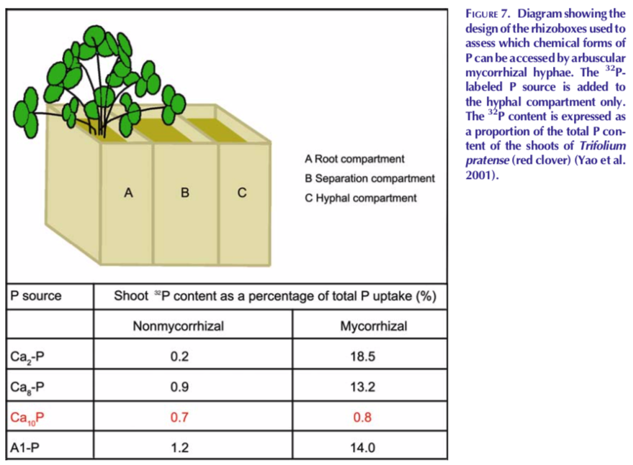
AM: Primary benefit is increased access to nutrients (not access to new nutrients)

Slide 10
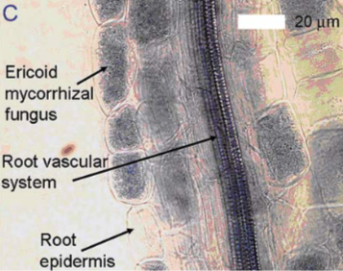
Ericoid Mycorrhiza
Restricted to bogs and heathlands in boreal areas
Heathers, bog berries, rhododendrons
Invade cells, but do not form arbuscules
Form coils instead
Infection is 100x greater than in AM
Can access organic N and P

Slide 11
Orchid mycorrhiza
Specific to orchids
Provide entire carbon source during orchid seed development
Provide nutrients later in life
Penetrate cells
Orchid-relationship can be parasitic to fungi

Slide 12
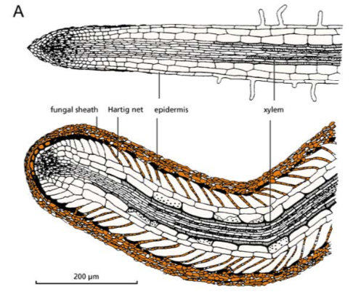
Ectomycorrhiza
Associations are more limited
Mainly trees: e.g., Pinus, Quercus, Salix, Fagus, Eucalyptus, Betula, Populus, Alnus, Fraxinus, Cupressus
Do not penetrate host cells
Exchange occurs in the intercellular spaces
Can access organic nutrient sources

Slide 13
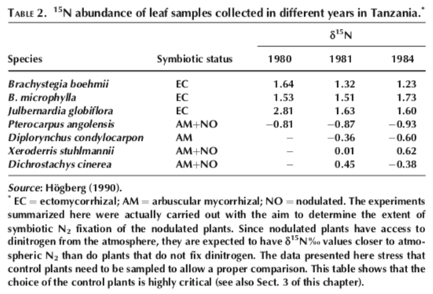
Organic vs. Inorganic nutrient acquisition
EC have different signature, suggesting acquisition from different source (organic in this case)

Slide 14
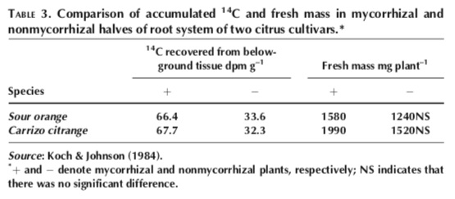
Carbon costs of mycorrhizal symbioses
4-20% of the carbon fixed by photosynthesis goes to symbioses
Total benefit is higher when water is limiting. Why?

Slide 15
Today’s symbioses
Mycorrhizae
N-fixing bacteria
Fungal endophytes

Slide 16
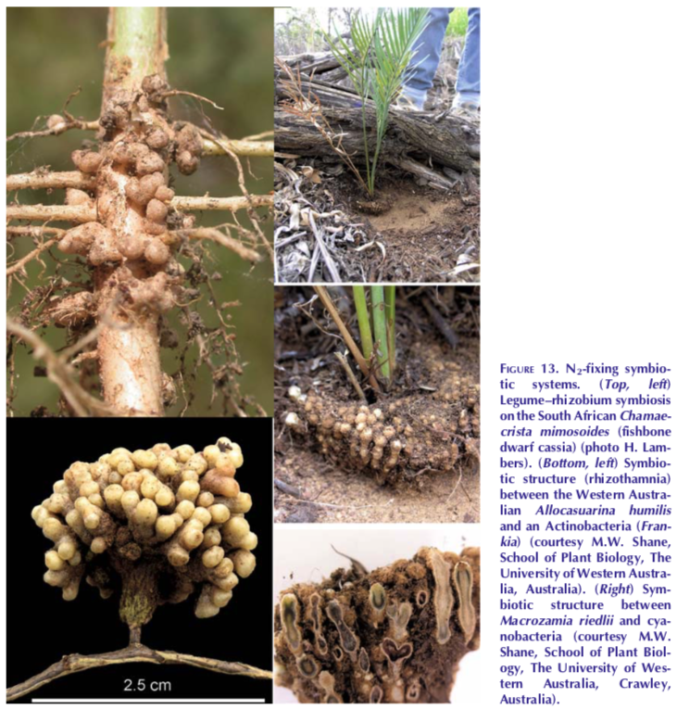
Nodule Forming Rhizobia
Convert N₂ gas into ammonia (NH₃)
Process plants can’t perform on their own
Form nodules on roots to exchange NH₃ with carbon
Only associate with Fabaceae family of plants (legumes)

Slide 17
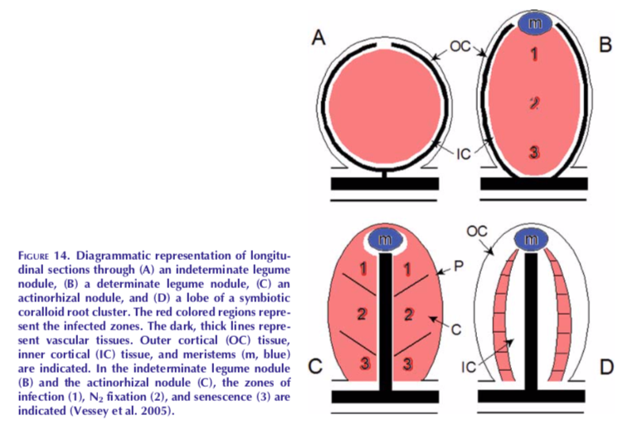
Nodule Forming Rhizobia

Slide 18
Fabaceae
The legumes!
Soybean
Alfalfa
Clover
Peas
Lentils
Mesquite
Peanuts
Tamarind

Slide 19
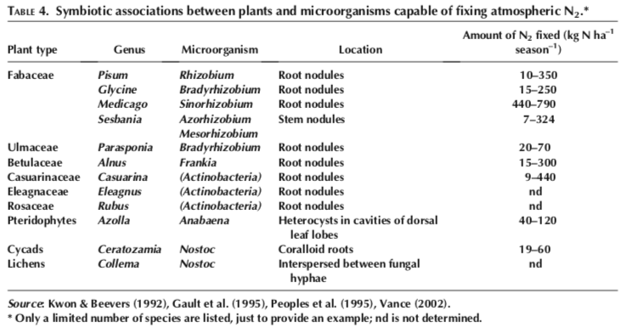
Fabaceae…and some other things

Slide 20
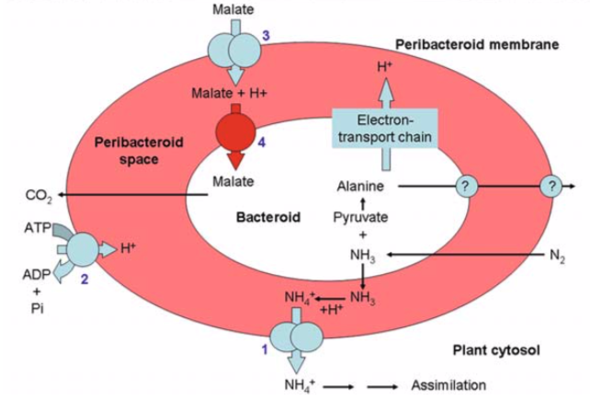
Carbon cost of the rhizobia symbiosis

Slide 21
Carbon cost of the rhizobia symbiosis
4-13% of photosynthate when soil N is high
25% or higher when soil N is low

Slide 22
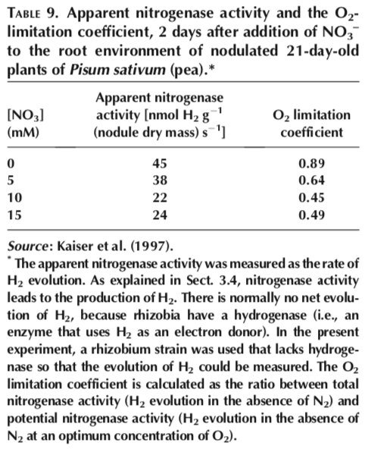
Suppression of rhizobia symbiosis
Presence of N reduces plant-mediated bacterial activity

Slide 23
Today’s symbioses
Mycorrhizae
N-fixing bacteria
Fungal endophytes

Slide 24
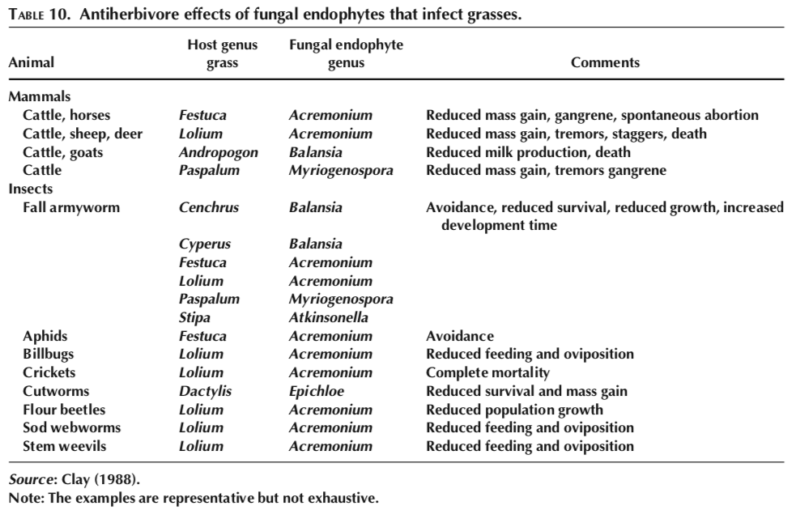
Fungal endophytes can harm herbivores

Slide 25
Fungal endophytes can increase stress tolerance
Hubbard et al. (2013)

Slide 26
Consequences for global change

Slide 27
Low = low Nitrogen
High = high Nitrogen
Terrer et al. (2016)

Slide 28
Low = low Nitrogen
High = high Nitrogen
Why would there be a difference between AM and ECM?
Terrer et al. (2016)

Slide 29
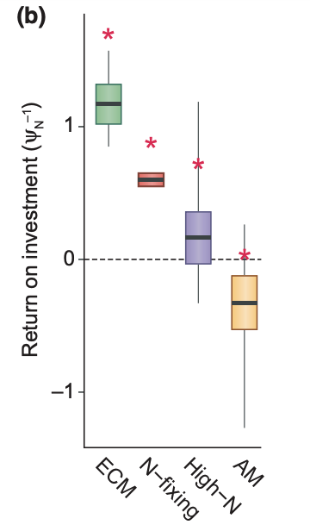
Higher N return per C invested in ECM than AM species
Terrer et al. (2018)

Slide 30
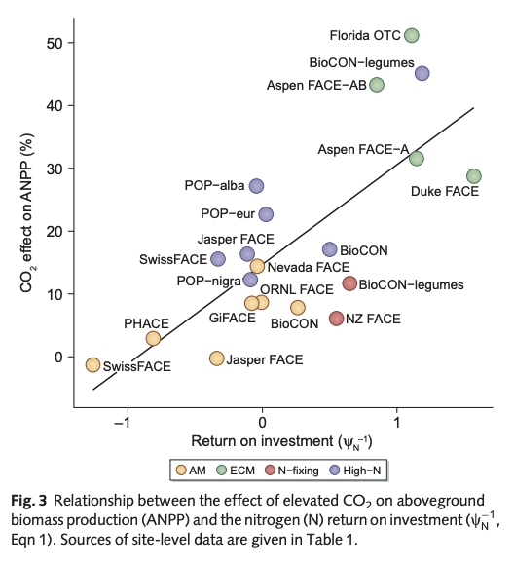
Terrer et al. (2018)

